Slide 1
Instagram User Analytics
(Project – 2)
- BY HITISHA SONI

Slide 2
Project Description :-
Imagine you're a data analyst working with the product team at Instagram.
Your role involves analyzing user interactions and engagement with the Instagram app to provide valuable insights that can help the business grow.
User analysis involves tracking how users engage with a digital product, such as a software application or a mobile app. The insights derived from this analysis can be used by various teams within the business.
Your insights will help the product manager and the rest of the team make informed decisions about the future direction of the Instagram app.

Slide 3
Approach :-
users
photos
comments
follows
tags
photo_tags
likes
In this project, as we are working with product team at Instagram.
We have few tables containing data relevant to the platform.
By these tables we can give insights to the marketing and product team to improve overall user experience.
Tables:

Slide 4
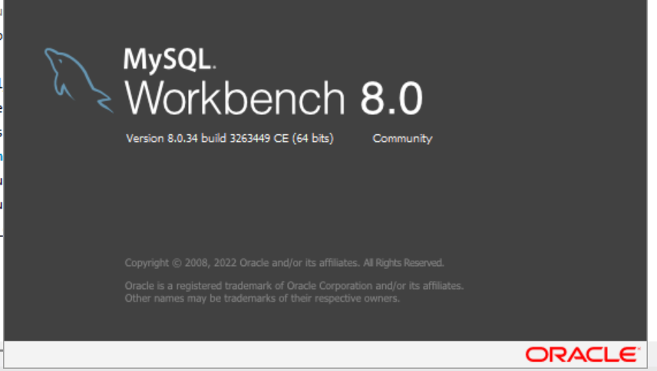
Tech-Stack Used:-
I used MySQL Workbench.
Version 8.0.34
Because it is very simple but effective tool to perform complex queries.
It has many features, it works as an IDE for SQL.

Slide 5
A) Marketing Analysis

Slide 6
1. Loyal User Reward: The marketing team wants to reward the most loyal users, i.e., those who have been using the platform for the longest time.
Your Task: Identify the five oldest users on Instagram from the provided database.
APPROACH :-
=> So, for this task I want data from users table only (to know the details about the users)
Selecting the id, username and the time at which they created account from users table
And to get the oldest time I have used min() to get the list of oldest users
Grouping the table by id and ordering by oldest user column in descending order so that oldest users can stay at the top
Now, As we have to identify top 5 oldest users so we are limiting the table rows upto 5 rows

Slide 7
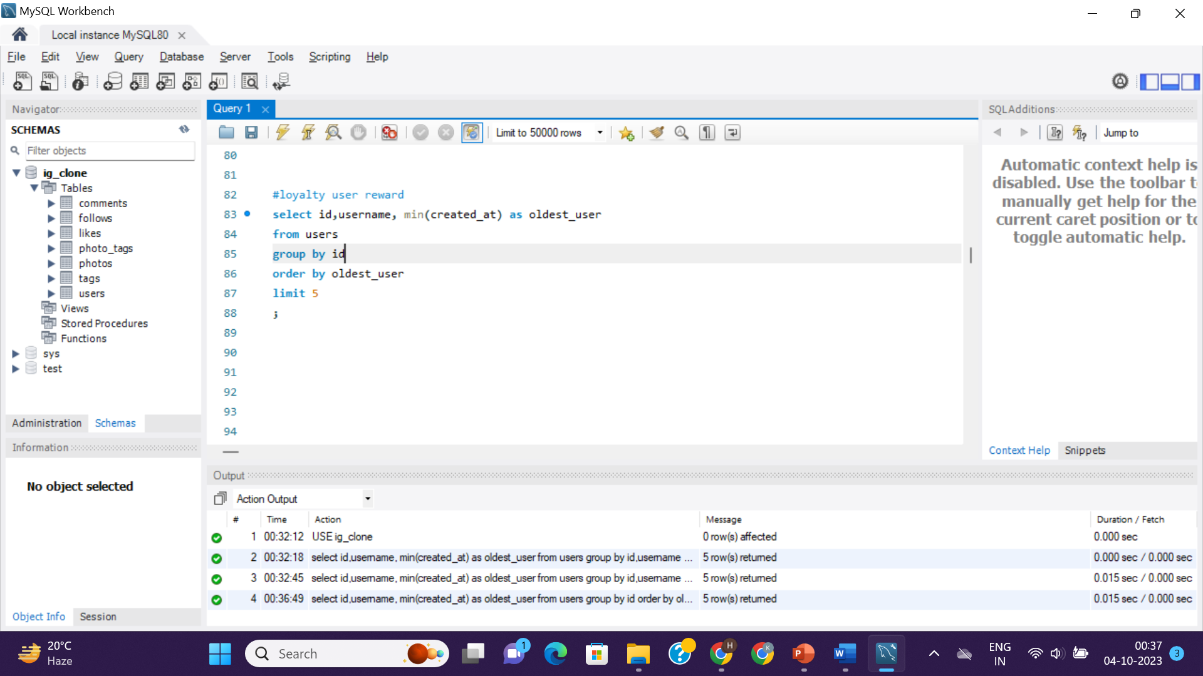
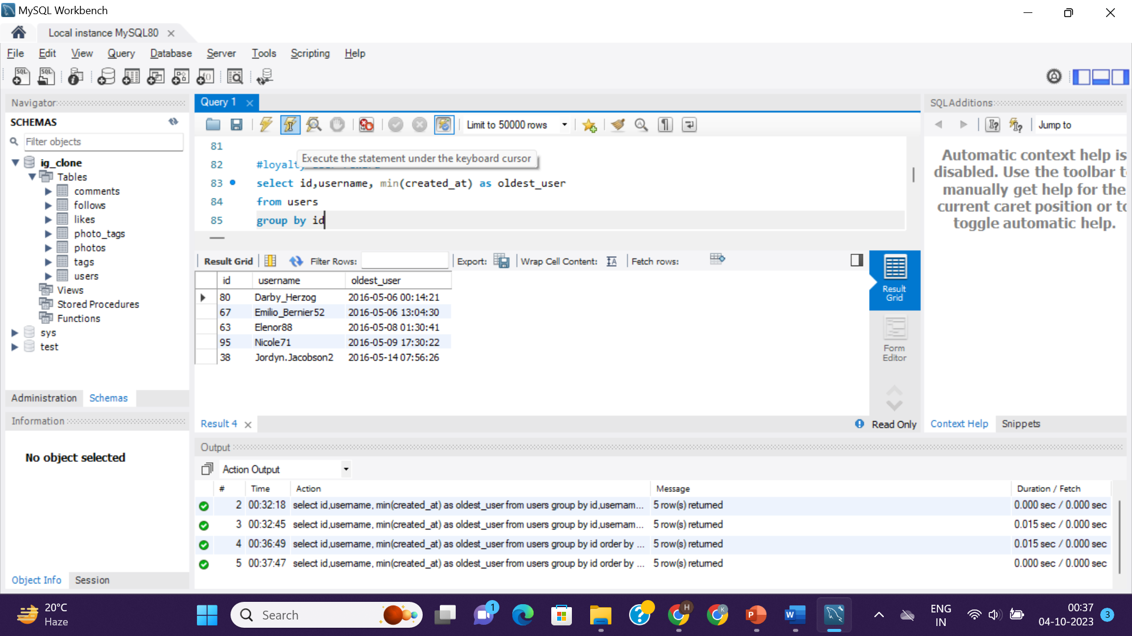
<= Query
Result =>

Slide 8
2. Inactive User Engagement: The team wants to encourage inactive users to start posting by sending them promotional emails.
Your Task: Identify users who have never posted a single photo on Instagram.
APPROACH :-
=> So, for this task I want data from users table (to know the details about the users) and photos table (to know that they have posted a photo or not)
Subquery - Firstly, selecting the users who have posted photo(s) on the platform by joining users and photos table
Then, Selecting all the distinct id, username from users table where id is not present in previous table that is subquery by using NOT IN operator
So, we got 26 rows that means 26 users are inactive

Slide 9
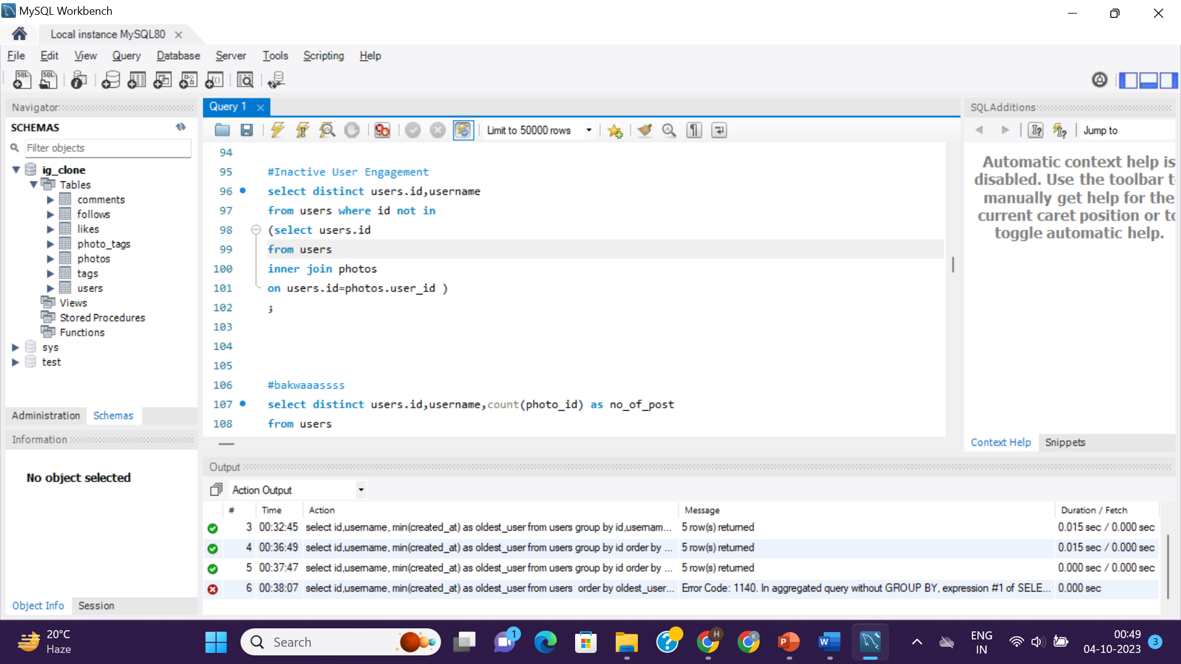
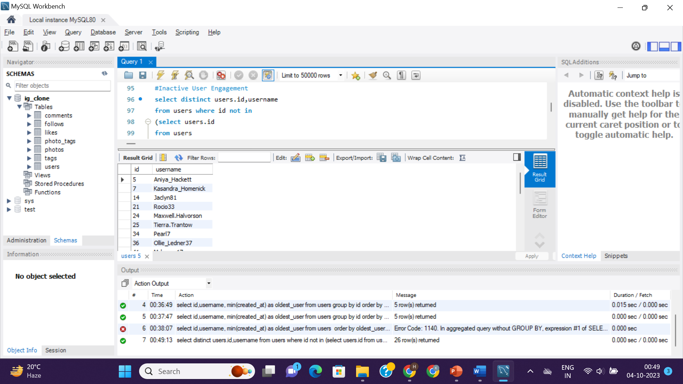
<= Query
Result =>

Slide 10
3. Contest Winner Declaration: The team has organized a contest where the user with the most likes on a single photo wins.
Your Task: Determine the winner of the contest and provide their details to the team.
APPROACH :-
=> So, for this task I want data from users table, photos table and likes table(to get the information of the user’s id, username and on which photo he/she posted got most likes)
Subquery - Firstly, created a table named “likes_no” which is made after joining likes table with users and photos table.
Using COUNT()- to count no. of users liked that particular post
Grouping by photo_id as we have to count likes on each post(by this subquery we got the records of photo_id, user_id, and likes on each post)
Now, for finding username of that user who got most likes, I have joined likes_no table again with users table and displayed all the necessary columns
Now, as the winner of this contest will be obviously one user, therefore limiting rows upto 1
So, we got the name, id, photo_id of that user who won the contest

Slide 11
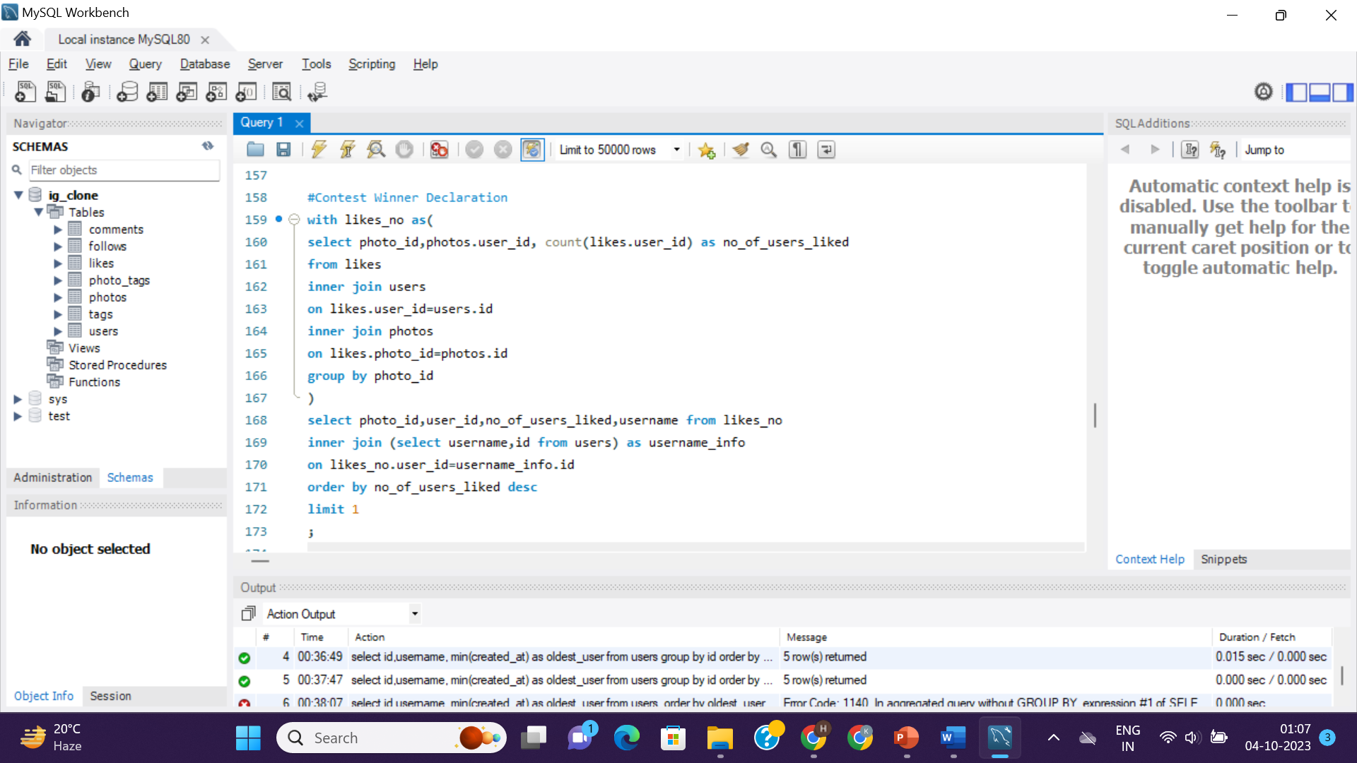
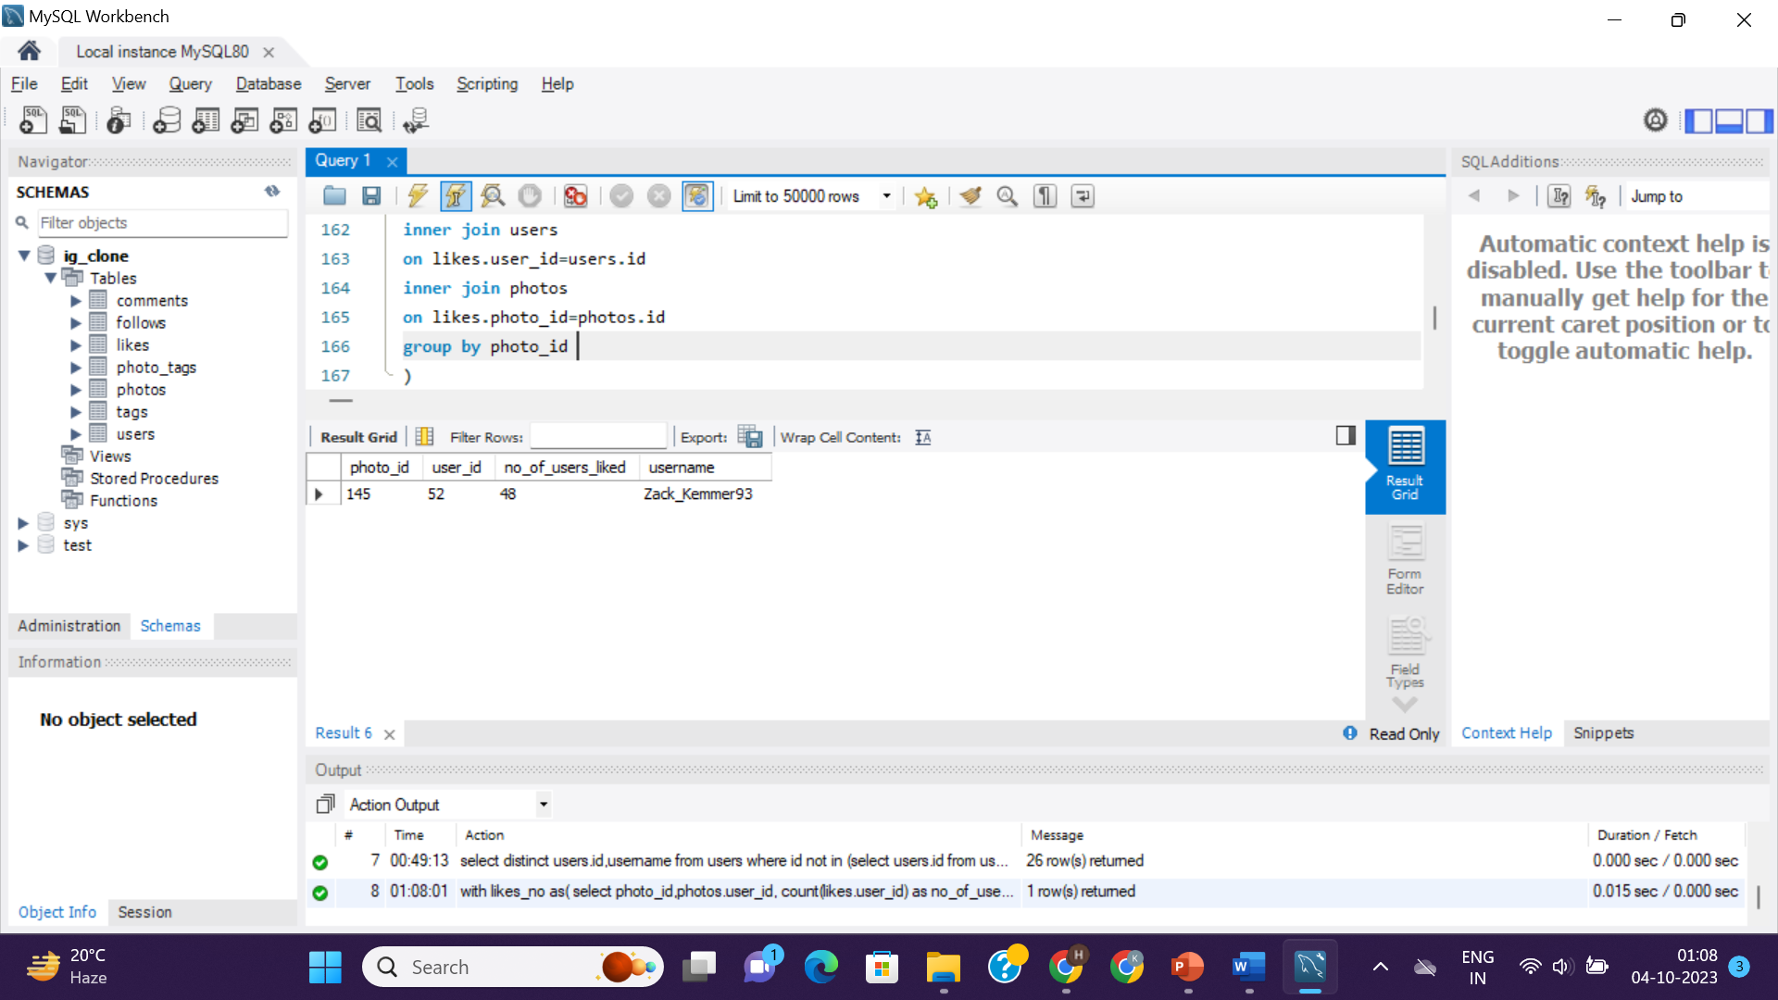
<= Query
Result =>

Slide 12
4. Hashtag Research: A partner brand wants to know the most popular hashtags to use in their posts to reach the most people.
Your Task: Identify and suggest the top five most commonly used hashtags on the platform.
APPROACH :-
=> So, for this task I want data from photo_tags table and tags table(to get the information of how many tags are used on posts, to identify most common tags)
Selecting tag_id, tag_name by joining photo_tags and tags table
Using COUNT()- to count no. of photos that used that one tag as tag_used_per_photo
Grouping by tag_id as we have to count how many photos used that one common tag
Ordering by tag_used_per_photo in descending order
Now, As we have to identify top 5 most commonly used tags, we are limiting the table rows upto 5 rows
So, we got the tag_name, tag_id, no. of tags used most frequently

Slide 13
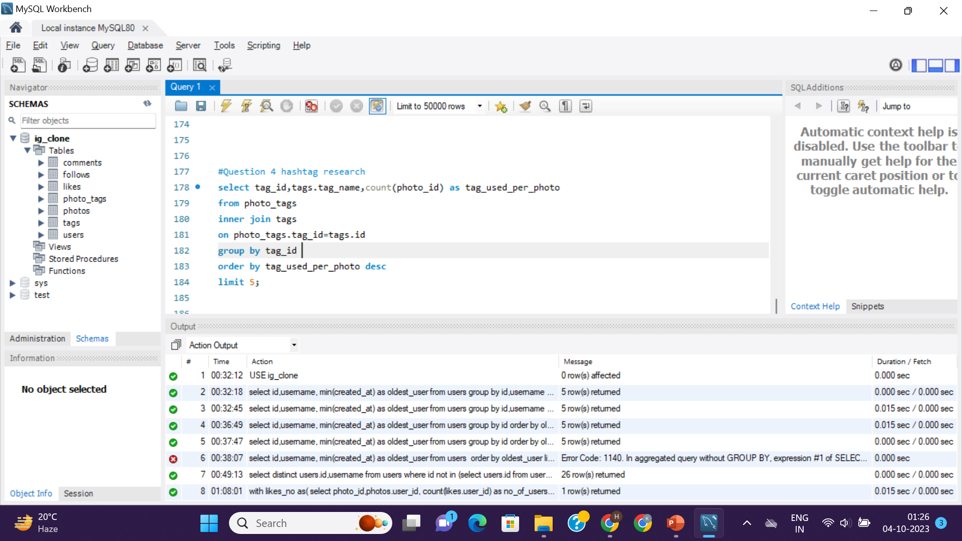
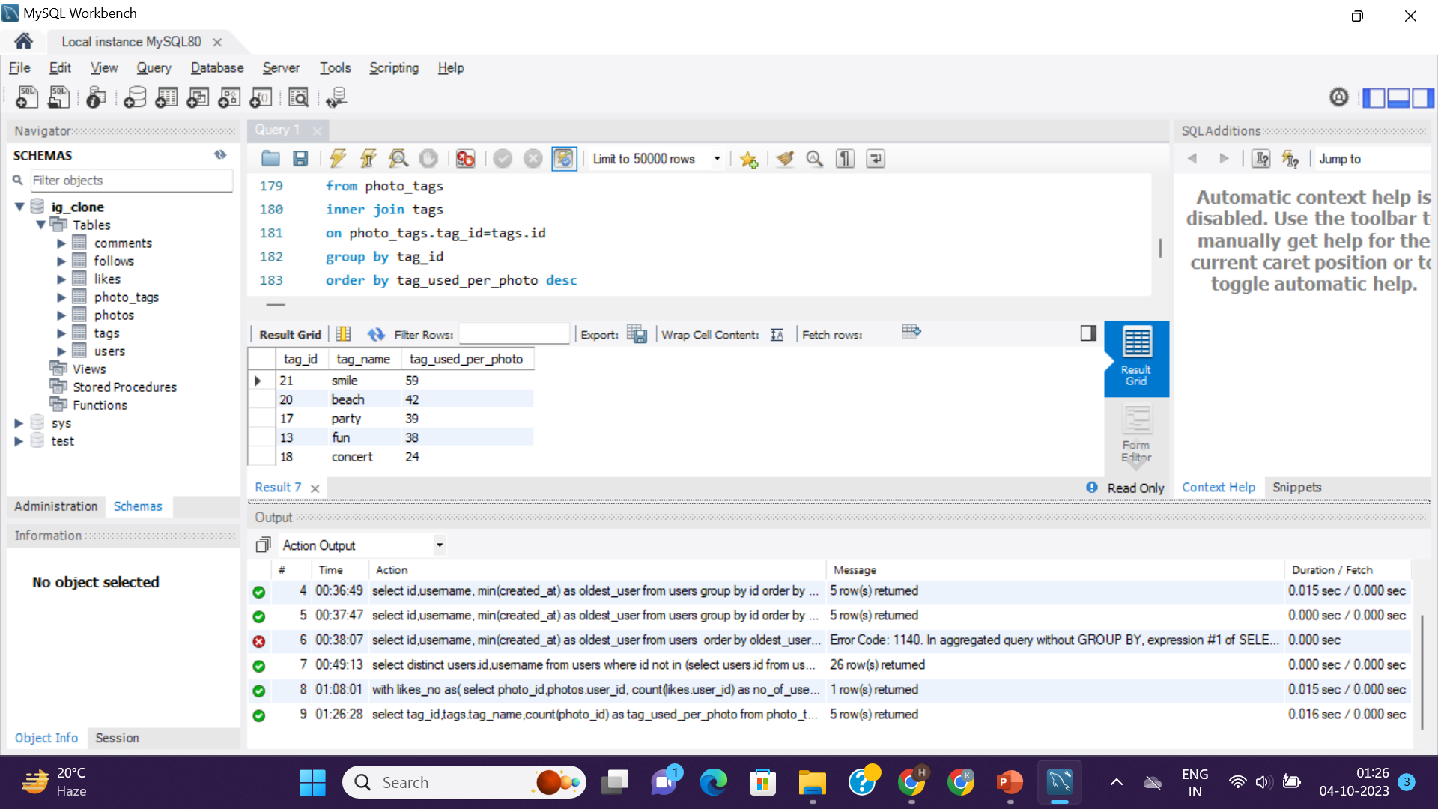
<= Query
Result =>

Slide 14
5. Ad Campaign Launch: The team wants to know the best day of the week to launch ads.
Your Task: Determine the day of the week when most users register on Instagram. Provide insights on when to schedule an ad campaign.
APPROACH :-
=> So, for this task I want data from users table only
Subquery - Firstly, created a table named “weekdays” from users table selecting id, username and weekday of the date when user created the account by using WEEKDAY()
Selecting week_day and using COUNT()- counting the id of users (at which day they are creating account the most)
Now, adding CASE to get the names of the day, i.e., 0=Monday;1= Tuesday,……6=Sunday.
Then, selecting all this from weekdays table, grouping by week_day(which we got from WEEKDAY())
Ordering by no_of_users in descending order
Now, we got the no. of users registered on the platform on which day
As by result, THURSDAY and SUNDAY are the days when most of users have registered

Slide 15
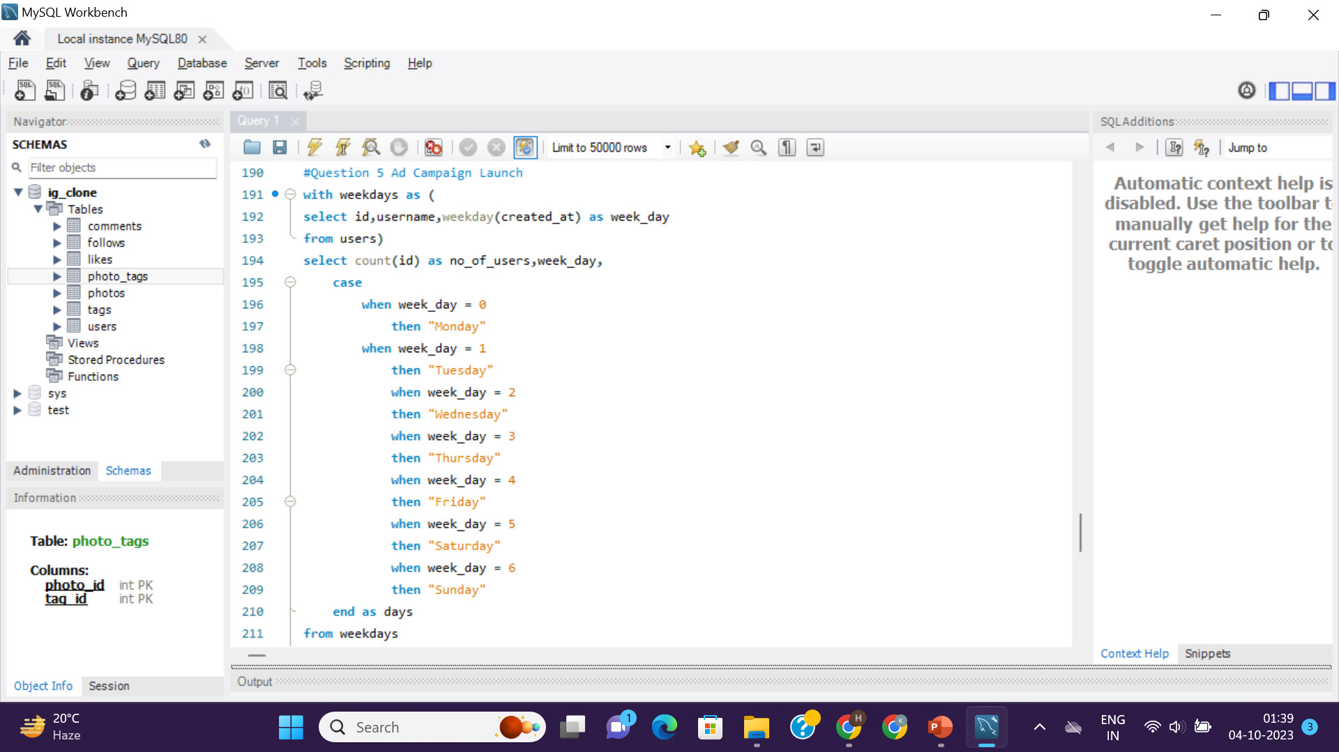
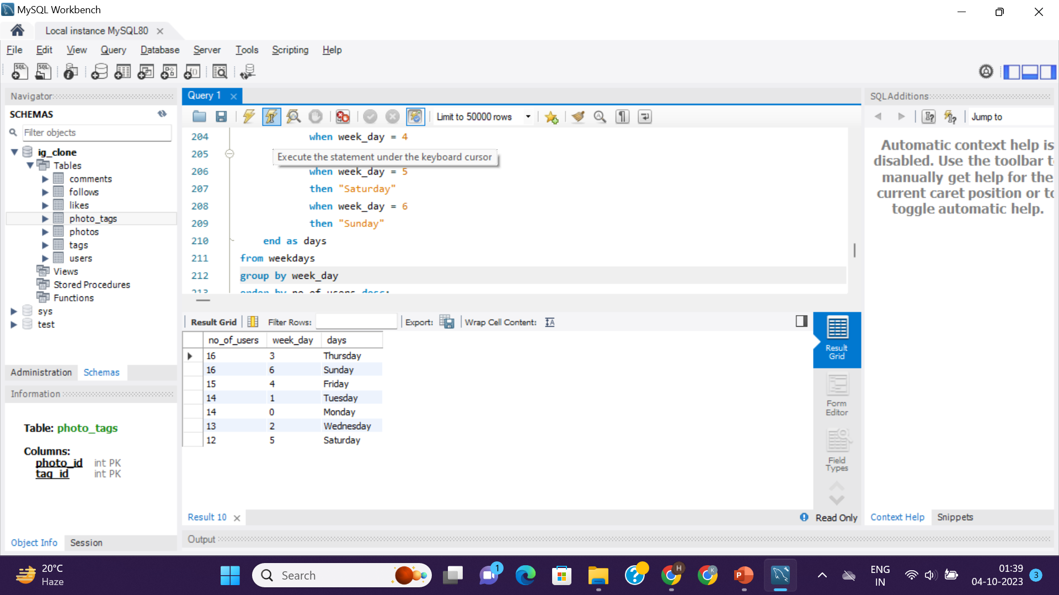
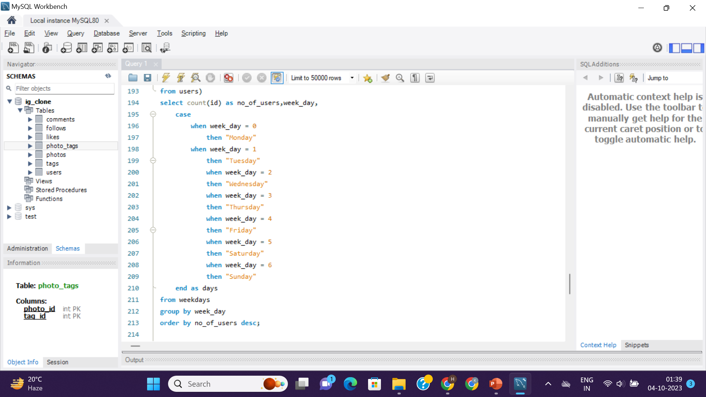
<= Query
Result =>

Slide 16
B) Investor Metrics

Slide 17
1. User Engagement: Investors want to know if users are still active and posting on Instagram or if they are making fewer posts.
Your Task: Calculate the average number of posts per user on Instagram. Also, provide the total number of photos on Instagram divided by the total number of users.
APPROACH :-
=> So, for this task I want data from users table and photos table
Firstly, for counting average no. of posts per user:
Selecting user’s id, and counting photo_id and then dividing the result by user_id to get an average as numPost by joining users and photos table
Grouping by user’s id (as we have to calculate average post per user)
Then we got the average no. of posts per user
Secondly, for counting total no. of posts / total no. of users:
Subquery - Firstly, created a table named “num_of_posts” which is made after left joining users and photos table. Selecting user_id, photo_id
Then, in outerquery, counting all the no. of posts and no. of users and dividing both as Total_posts/Total_users

Slide 18
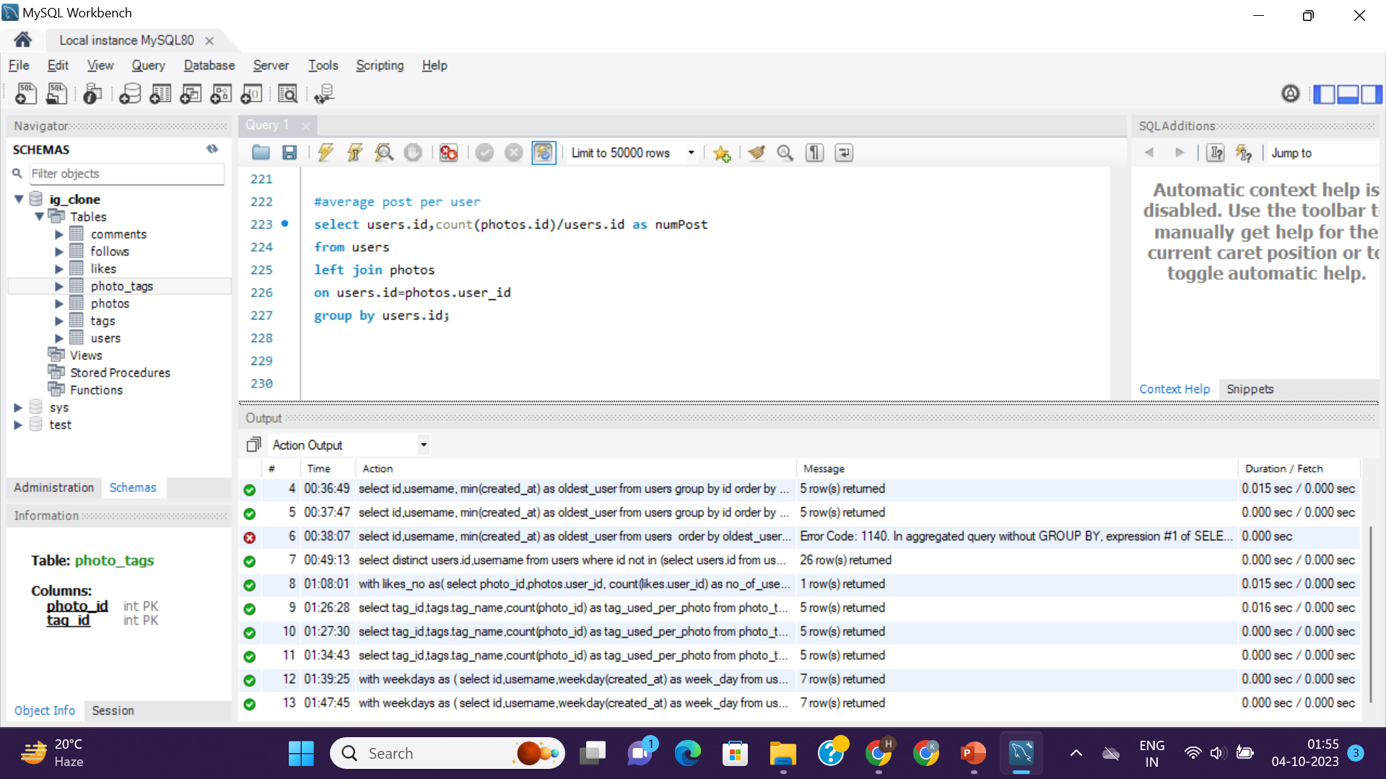
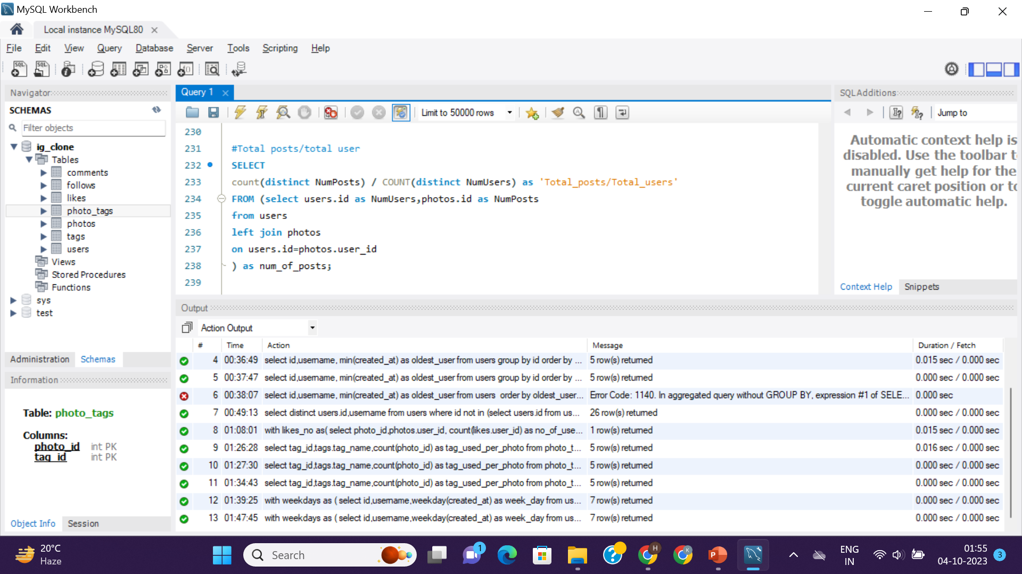
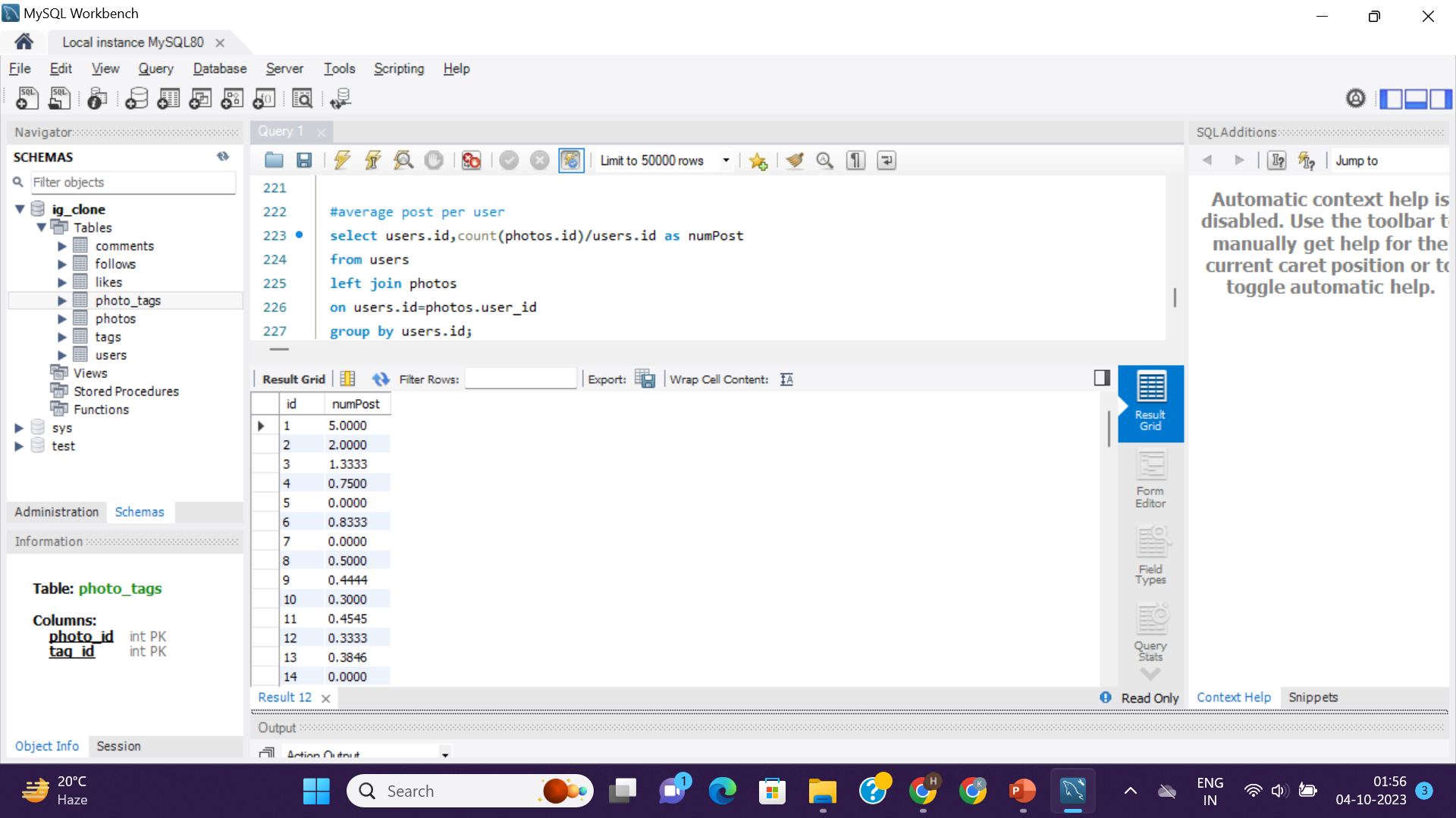
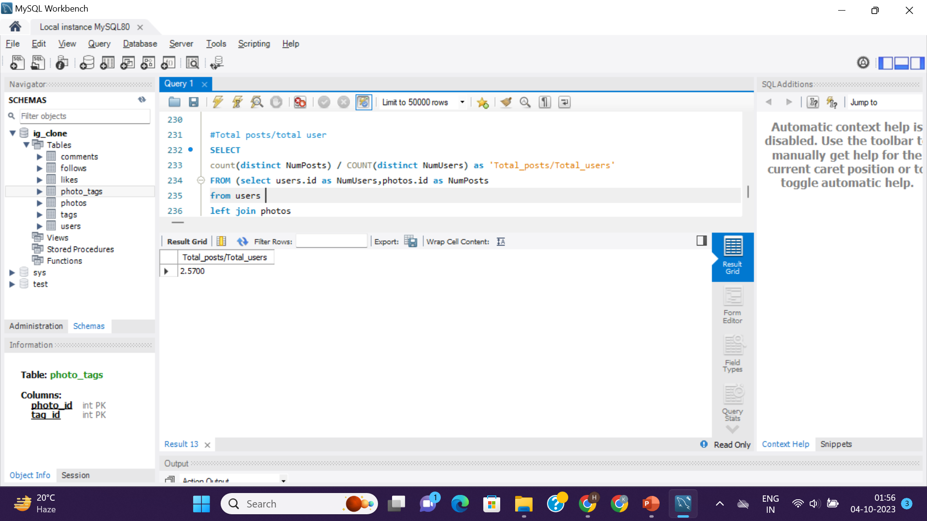
Query =>
Result =>
Upto 100 rows: as there are 100 users

Slide 19
2. Bots & Fake Accounts: Investors want to know if the platform is crowded with fake and dummy accounts.
Your Task: Identify users (potential bots) who have liked every single photo on the site, as this is not typically possible for a normal user.
APPROACH :-
=> So, for this task I want data from users table and likes table
Selecting user’s id,username and counting photo_id –where each users have liked as no_of_posts_liked by joining likes and users table
Grouping by user’s id (as we have to calculate likes on post grouped by user)
Using having clause to identify the users who have liked each and every photos
For this, we should know how many posts are there-
we can get this by using simple count(photos.id) from photos command
Or by declaring total no. of post by using SET command to declare variable and use that variable in having clause condition
So, in our data set there are total 257 posts, so the users whose no_of_posts_liked is 257 are the bots and fake accounts

Slide 20
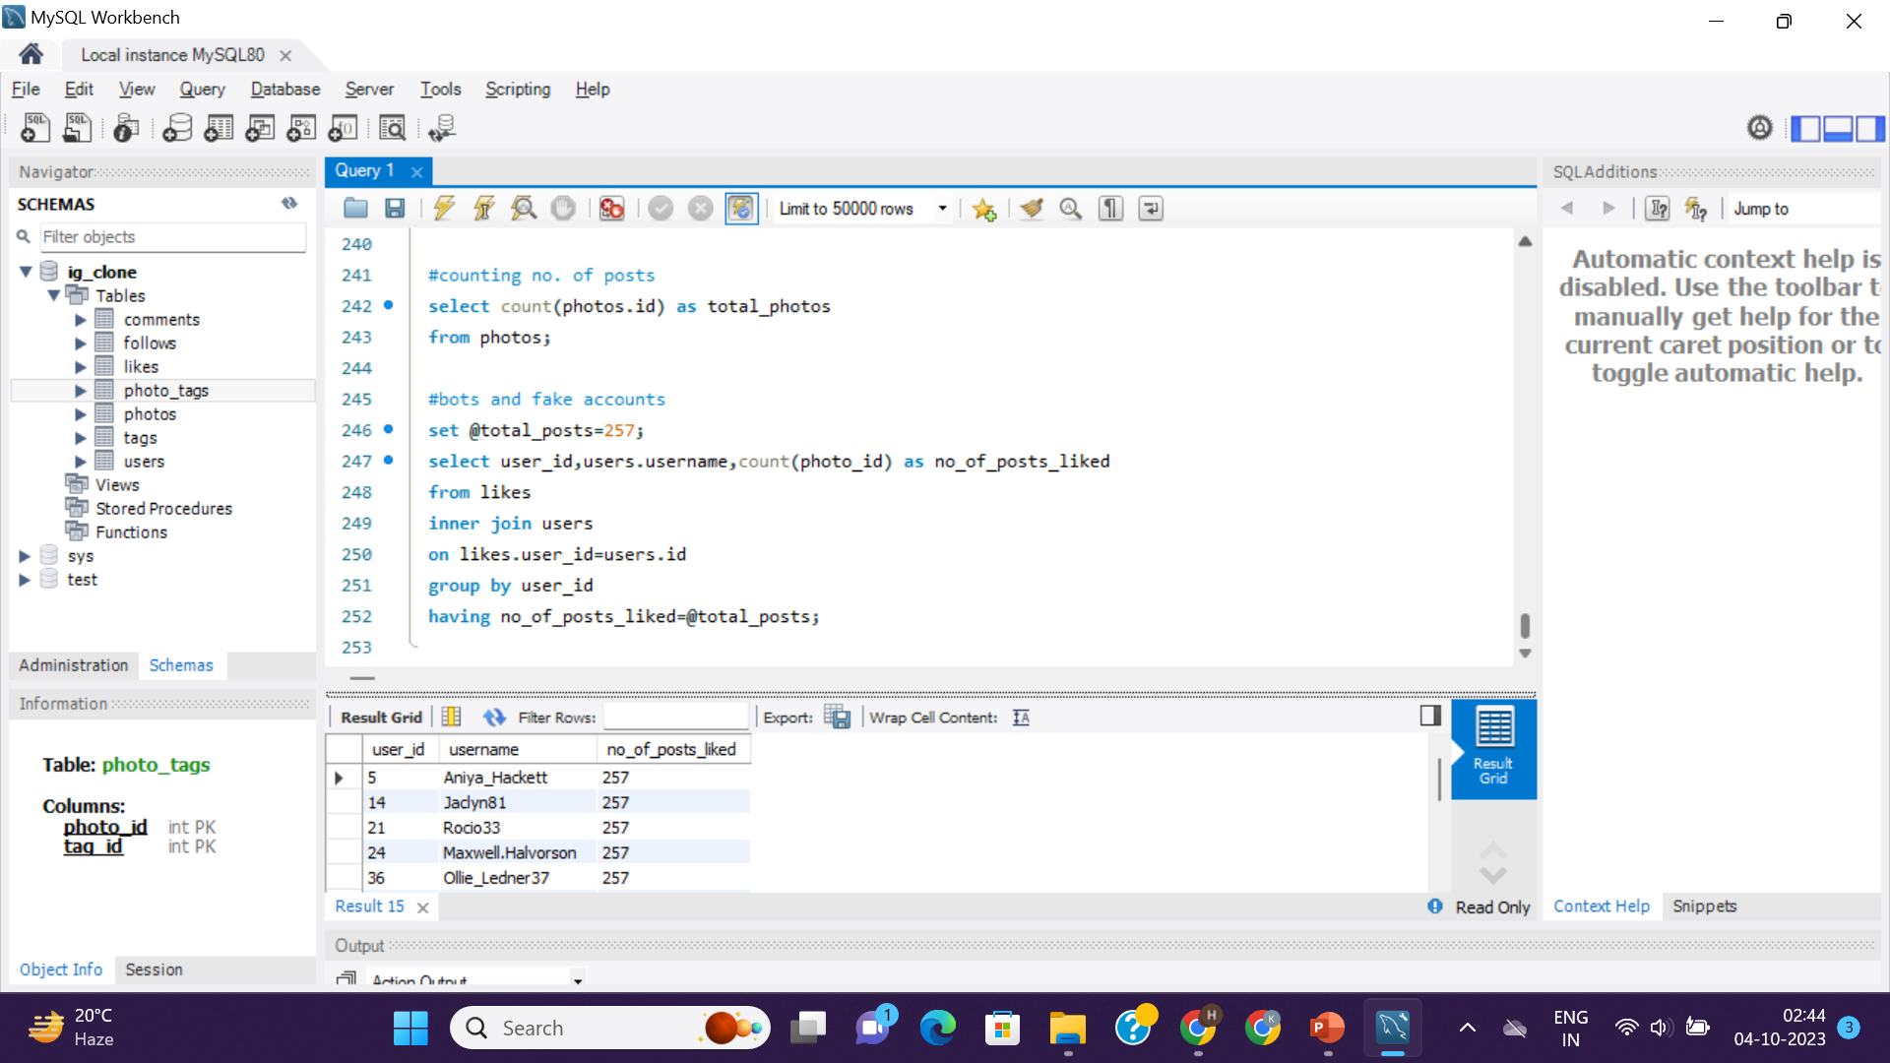
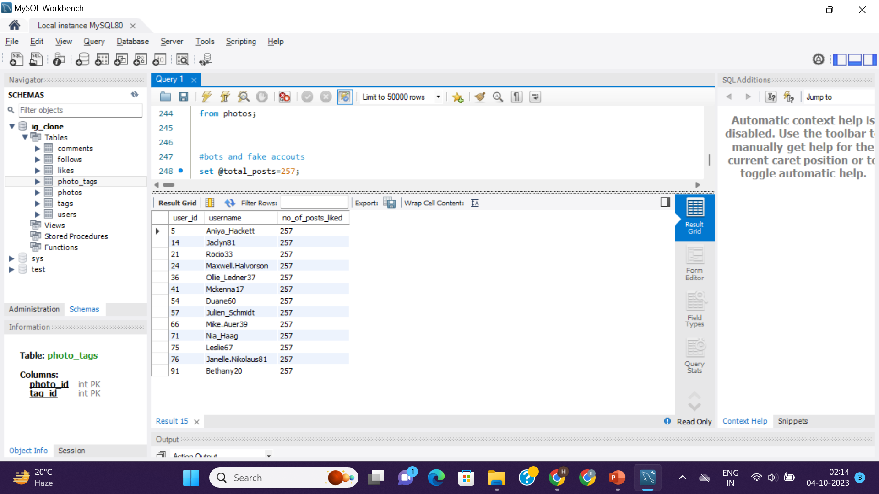
<= Query
Result =>

Slide 21
Insights & Results :-
By doing this project, I have gained a very deep knowledge about SQL and SQL Workbench
Now, I can feel confident about SQL
Improved my problem solving skills
I can get to know some real-life problems and requirements any company can provide and asks us to give them insights to take informed decisions
I think it is little bit tricky project but definitely enhanced my analytical skills like how we can implement things which we are studying

Slide 22
Thank You

